Slide 1
Request - Response
Best Practices

Slide 2
Request
Request Method (HTTP)
→ GET()
→ POST()
→ PUT()
→ DELETE()

Slide 3
GET()
Simple GET() Request
GET() Request With URL Query
GET() Request Header

Slide 4
POST()
Simple POST() Request
POST() Request With URL Query
POST() Request Header
POST() Request JSON in Body
→ For this we have to install ‘body-parser’ node package by ‘npm install body-parser’
→ Then, invoking through require(’body-parser’)
→ Then we have to use it “app.use(bodyParser.json())”
→ Only then we can call body in callback function
→ If we want to see json data, we have to convert it into string by “JSON.stringify(data)”
→ We have to send json data in body before sending post request

Slide 5
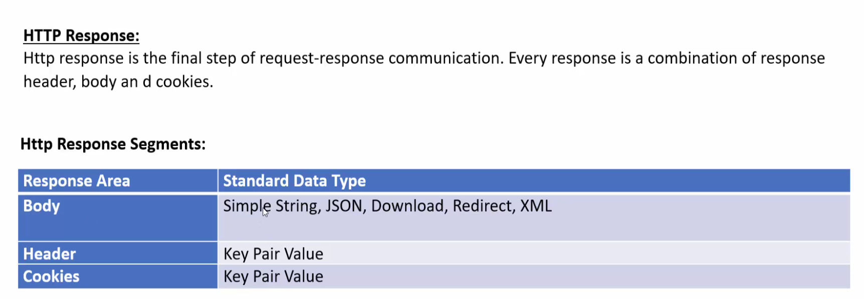
Response

Slide 6
→ 4 parts: response body, response header, response status, response cookies
→ Analyze using postman, postman console
→ Body contains different data (json, xml, html etc.)
→ We can add extra data in header
→ Study on response status codes
→ We can send data in cookies

Slide 7
Different types of response:

Slide 8
Simple String Response
var express = require('express');
app = express();
app.get('/', (req, res) => {
try {
res.end("this is get string response");
}
catch (error) {
console.log(error);
}
});
// res.send() - response body
// res.end() - response end point
app.post('/', (req, res) => {
try {
res.send("this is string post response")
}
catch (error) {
console.log(error);
}
});
app.listen(8080, () => {
console.log("server connection successful");
});

Slide 9
Response Status Code
var express = require('express');
app = express();
app.get('/three', (req, res) => {
try {
// res.status(201).end();
res.status(401).end("unauthorized");
}
catch (error) {
console.log(error);
}
});
app.listen(8080, () => {
console.log("server connection successful");
});

Slide 10
JSON Response
var express = require('express');
app = express();
app.get('/json', (req, res) => {
try {
let myJsonArray = [
{
name: "saad",
age: "25",
city: "Rajshahi"
},
{
name: "raad",
age: "22",
city: "Gaibandha"
},
{
name: "sakib",
age: "24",
city: "Tangail"
}
]
res.json(myJsonArray);
}
catch (error) {
console.log(error);
}
});
app.listen(8080, () => {
console.log("server connection successful");
});

Slide 11
Download Response
var express = require('express');
app = express();
app.get('/download', (req, res) => {
try {
res.download('../images/black.jpg');
}
catch (error) {
console.log(error);
}
});
app.listen(5000, () => {
console.log("server connected");
});

Slide 12
Response Redirect
var express = require('express');
app = express();
app.get('/bangladesh', (req, res) => {
try {
res.redirect('http://localhost:5000/pakistan');
}
catch (error) {
console.log(error);
}
});
app.get('/pakistan', (req, res) => {
try {
res.send("This is Pakistan.");
}
catch (error) {
console.log(error);
}
});
app.listen(5000, () => {
console.log("server connected");
});

Slide 13
Response Header
→ Should store value in key: value order
→ To add info in header, res.append(”name”, “saad”)
var express = require('express');
app = express();
app.get('/header', (req, res) => {
try {
res.append("name", "saad");
res.append("age", "25");
res.append("city", "rajshahi");
res.status(201).end("This is header.");
}
catch (error) {
console.log(error);
}
});
app.listen(5000, () => {
console.log("server connected");
});

Slide 14
Response Set Cookies
→ Should store value in key: value order
var express = require('express');
app = express();
app.get('/cookie', (req, res) => {
try {
res.cookie("name", "saad");
res.cookie("age", "25");
res.cookie("city", "rajshahi");
res.end("cookie set successfully");
}
catch (error) {
console.log(error);
}
});
app.listen(5000, () => {
console.log("server connected");
});

Slide 15
Response Clear Cookies
var express = require('express');
app = express();
app.get('/clrcookie', (req, res) => {
try {
res.clearCookie("name", "saad");
res.clearCookie("age", "25");
res.end("cookie cleared successfully");
}
catch (error) {
console.log(error);
}
});
app.listen(5000, () => {
console.log("server connected");
});

Slide 16
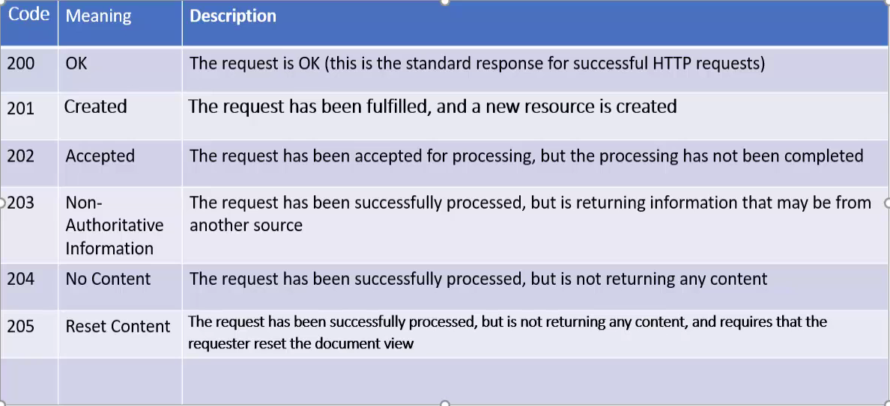
Response Status Code

Slide 17
